Slide 1

CSE-4078
Mobile Application Development
Lectures – Week 1
Sara Masood

Slide 2
Introduction to course
Course code: CSE-4078
Course title: Mobile App Development
Credit hours: 2+1

Slide 3
Course learning outcomes
CLO # | Description | PLO # | Taxonomy level
CLO-1 | Understand mobile application development's fundamental concepts (e.g., widgets, themes, and app state). | PLO 2 | Cogitative - Understanding
CLO-2 | Develop stateful, cross-platform, and interactive user interfaces for mobile applications. | PLO 4 | Cogitative - Applying
CLO-3 | Develop cross-platform and data-driven mobile applications. | PLO 4 | Cogitative - Applying

Slide 4

Challenges
In native development, separate code base for Android, Web, and IOS.

Slide 5
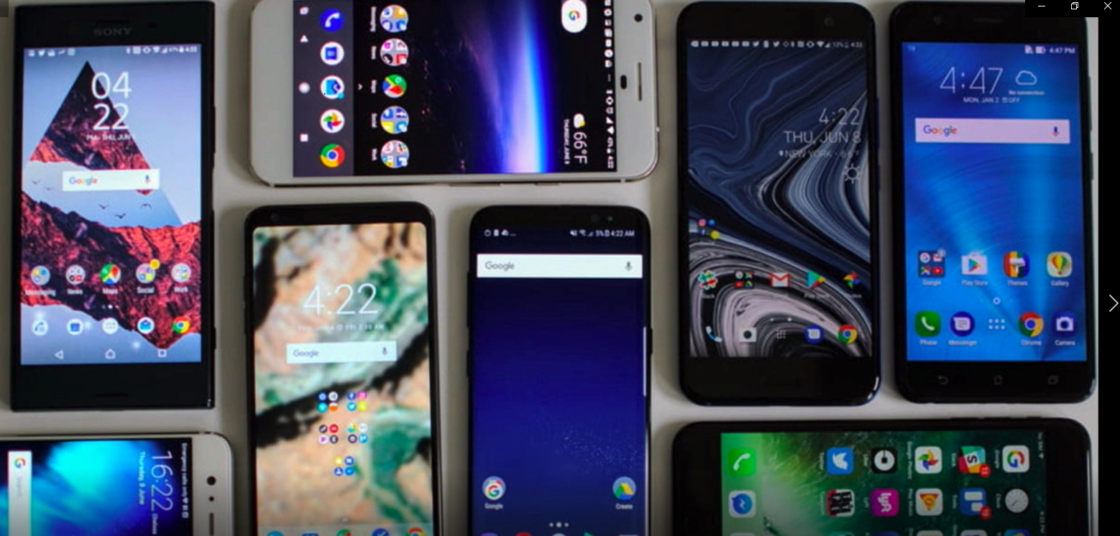
Challenges
Different screen sizes

Slide 6
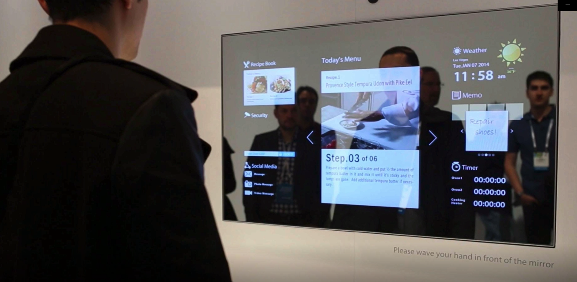
Challenges
Different screen sizes of device

Slide 7


Slide 8


Slide 9
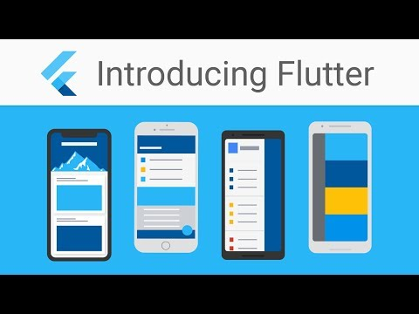
What is Flutter?
Flutter is Google’s UI toolkit for building beautiful, natively compiled applications for mobile, web, and desktop from a single codebase.
Flutter in native language is an app SDK by Google which can help you code for Android as well as iOS on a single codebase. It is used for building high-performance apps for Android, iOS, Web and Desktop.

Slide 10
Why Flutter?
One code base to rule them all. You only need to know programming level Dart, which is very powerful language.
Dart is like many object-oriented languages; it is used to build Android and IOS application.
A simple and Flexible layout system : Remember one thing before anything, that Everything is a Widget in Flutter.
  A widget is used everywhere in Flutter starting from the most basic Material Design to the most enhanced one.
Fast Development

Slide 11
Why Flutter?
Native Performance : Flutter provides various pre-defined widgets and classes for a full native feel of the app on Android or on iOS.

Slide 12

Flutter and DART
Flutter - Build apps for any screen
Dart programming language | Dart

Slide 13
Dart

Slide 14
Important concepts
Everything you can place in a variable is an object, and every object is an instance of a class.
Even numbers, functions, and null are objects.

Slide 15
Important concepts – Null safety
The Dart language now supports sound null safety!
Types in your code are non-nullable by default, meaning that variables can’t contain null unless you say they can.
With null safety, all of the variables in the following code are non-nullable
// In null-safe Dart, none of these can ever be null.
var i = 42; // Inferred to be an int.
String name = getFileName();
final b = Foo();

Slide 16
Important concepts – Null safety
To indicate that a variable might have the value null, just add ? to its type declaration
int? aNullableInt = null;
Sound null safety | Dart

Slide 17
Main function
Every app has a main() function
void main() {
print('Hello, World!');
}

Slide 18
Comments
Dart comments usually start with //
// This is a normal, one-line comment.
/// This is a documentation comment, used to document libraries,
/// classes, and their members. Tools like IDEs and dartdoc treat
/// doc comments specially.
/* Comments like these are also supported. */

Slide 19
Imports
To access APIs defined in other libraries, use import.
// Importing core libraries
import 'dart:math';
// Importing libraries from external packages
import 'package:test/test.dart';
// Importing files
import 'path/to/my_other_file.dart';

Slide 20
Variables
An example of creating a variable and initializing it:
  var name = 'Bob’;
Variables store references. The variable called name contains a reference to a String object with a value of “Bob”.
The type of the name variable is inferred to be String.

Slide 21
variables
If an object isn’t restricted to a single type, specify the Object type (or dynamic if necessary)
  Object name = 'Bob’;

Slide 22
variables
Another option is to explicitly declare the type that would be inferred:
  String name = 'Bob’;

